Slide 1

Project Phase-II
Review-3
PJ21CS02 - Breast Cancer Detection System
By
Adithya Sunder-1VI18CS002
Nithin Kumar B- 1VI18CS069
Santhosh B Rao-1VI18CS094
Shashank P - 1VI18CS099
Under the Guidance of
Mrs. Mary Vidya John
Assistant Professor

Slide 2
BIRD VIEW
BREAST CANCER DETECTION SYSTEM
2021- 22
Introduction to the work (Background)
Motivation
Literature Survey
Comparative analysis of the survey
Problem Statement
System Specification
Objectives
Design Methodology
Module Description
References
1

Slide 3
INTRODUCTION
2021- 22
BREAST CANCER DETECTION SYSTEM
There have been several empirical studies addressing breast cancer using machine learning and soft computing techniques. We have chosen some aspects which act as the most important parameters in this project.
They are: Accuracy, Precision and Recall
2

Slide 4
MOTIVATION
2021- 22
BREAST CANCER DETECTION SYSTEM
The incidence of breast cancer is low in India but rising. Breast cancer is the most common cancer of urban Indian women and the second most common in the rural women.
We aim to get rid of the stigma and battle the disease in the early stages.
The quality of care available for breast cancer patients varies widely according to where the patient is treated.
Date : 09/05/2022
3

Slide 5
LITERATURE SURVEY - 1
2021- 22
BREAST CANCER DETECTION SYSTEM
Machine Learning model for Breast Cancer Prediction[Ankur Gupta, Muskan Garg,Apurv Varma, Dushyant Kaushik]
Methodology: Convolutional neural network has been used in the identification of breast cancer. In this method first of all pictures are organized. After that, the organized picture is separated on the basis of its qualities. In the next step these pictures are developed in a new form and in the end prediction work is done. For the reduction of comparison time, space edge based pictures are taken. Due to this, performance increases.
Advantage: Less time consumption and more accuracy
Disadvantage: Not enough research ongoing about graphic processing .
Date : 09/05/2022
4

Slide 6
LITERATURE SURVEY - 2
2021- 22
BREAST CANCER DETECTION SYSTEM
Breast Cancer Prediction Analysis using Machine Learning Algorithms[ Vinayak A Telsang,Kavyashree Hegde]
Methodology: Dataset of breast cancer is taken. During the preprocessing stage, attributes, targets and normalization is done. Correlation matrix is plotted.After looking at the positive and negative correlated features, linear kernel function is used for prediction.
Advantage: Tests multiple algorithms. All of them have an accuracy of over 90%.
Disadvantage: Detailed analysis should be done before implementing on a large scale .
Date : 09/05/2022
5

Slide 7
LITERATURE SURVEY - 3
2021- 22
BREAST CANCER DETECTION SYSTEM
Breast Cancer Risk Prediction based on Six Machine Learning Algorithms[Md.Razu Ahmed, Md. Asraf Ali,Joy Roy,Shakil Ahmed, N Ahmed]
Methodology: Wisconsin Breast Cancer Dataset has been used here.Logistic Regression, SVM,Naïve Bayes, Random Forest, Knearest and Decision Tree algorithms have been studied and results have been found out.
Advantage: All algorithms have been tested and highest accuracy is from the SVM with 97% accuracy
Disadvantage: Since the highest accuracy is 97%, more work has to be done to implement this in a larger scale.
Date : 09/05/2022
6

Slide 8
LITERATURE SURVEY - 4
2021- 22
BREAST CANCER DETECTION SYSTEM
Prediction of Breast Cancer, Comparative Review of Machine Learning Techniques and their Analysis[Noreen Fatima, Li Liu,Hong Sha,Haroon Ahmed]
Methodology: The paper has compared how machine learning techniques fare when it comes to breast cancer prediction. The researchers have used Artificial Neural Networks, Logistics Regression,SVM, Knearest Neighbor ,Decision tree and other techniques.
Advantage: Effective way of prediction of malignant tumors.
Disadvantage: Dataset issues need solving.
Date : 09/05/2022
7

Slide 9
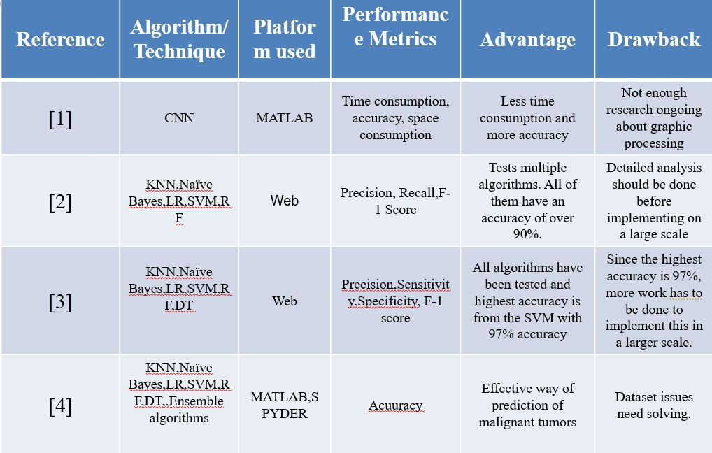
COMPARATIVE ANALYSIS
2021- 22
BREAST CANCER DETECTION SYSTEM
Date : 09/05/2022
8

Slide 10
PROBLEM STATEMENT
2021- 22
BREAST CANCER DETECTION SYSTEM
Considering all the research that has gone into making this proposal, our task is to develop a model which has high:
Accuracy
Precision
Recall
9

Slide 11
SYSTEM SPECIFICATION
2021- 22
BREAST CANCER DETECTION SYSTEM
Hardware requirements
i3processor or equivalent.
RAM- 2GB
Software requirements
Any web browsing client (Example- Microsoft Edge)
10

Slide 12
OBJECTIVES
2021- 22
BREAST CANCER DETECTION SYSTEM
To complete this project, we have delineated the entire process by splitting it into 5 Objectives. They are:
Dataset analysis , Loading Libraries and reading the data from the dataset
Exploratory Data Analysis
Principal Component Analysis
Predictive Models
Deploying the project on a website
11

Slide 13
DESIGN METHODOLOGY
2021- 22
BREAST CANCER DETECTION SYSTEM
Objective 1: Dataset analysis , Loading Libraries and Reading the Data from the dataset
Load the libraries
Read the data
Find the missing values
Drop error tables
Objective 2: Exploratory Data Analysis
Target and Feature distribution
Correlation matrix
12

Slide 14
DESIGN METHODOLOGY
2021- 22
BREAST CANCER DETECTION SYSTEM
Objective 3:Principal Component Analysis:
Compute PCA
Plot with the desired number of components
Objective 4: Predictive Models:
Prepare the dataset
Define the functions
Train the model
Objective 5: Deploy the project on a website:
Use Django for the backend and HTML/CSS for the front-end to create a website.
13

Slide 15
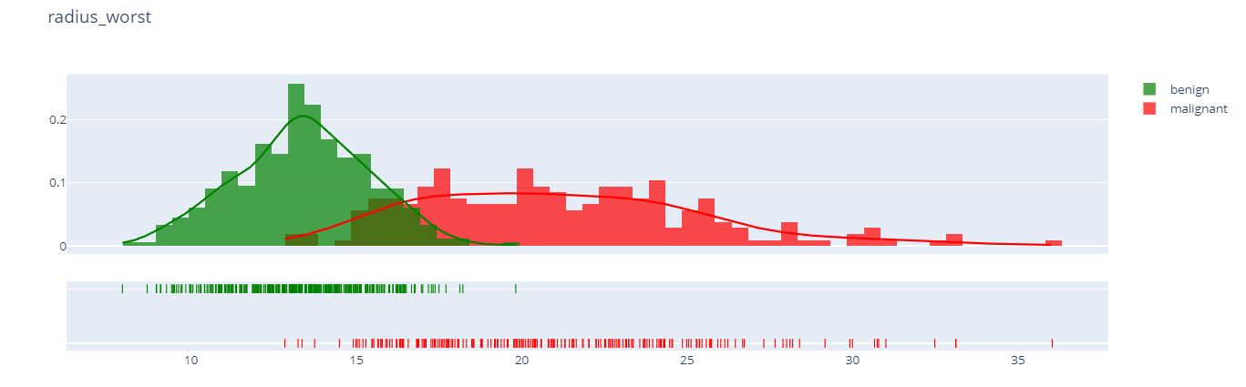
MODULE DESCRIPTION
2021- 22
BREAST CANCER DETECTION SYSTEM
Module 1:Exploratory Data Analysis:
In this module, we perform some initial investigations on the data so that we can discover patterns, anomalies etc
We can make graphical representations and compare the extremities of our dataset
Example from the project:
14

Slide 16
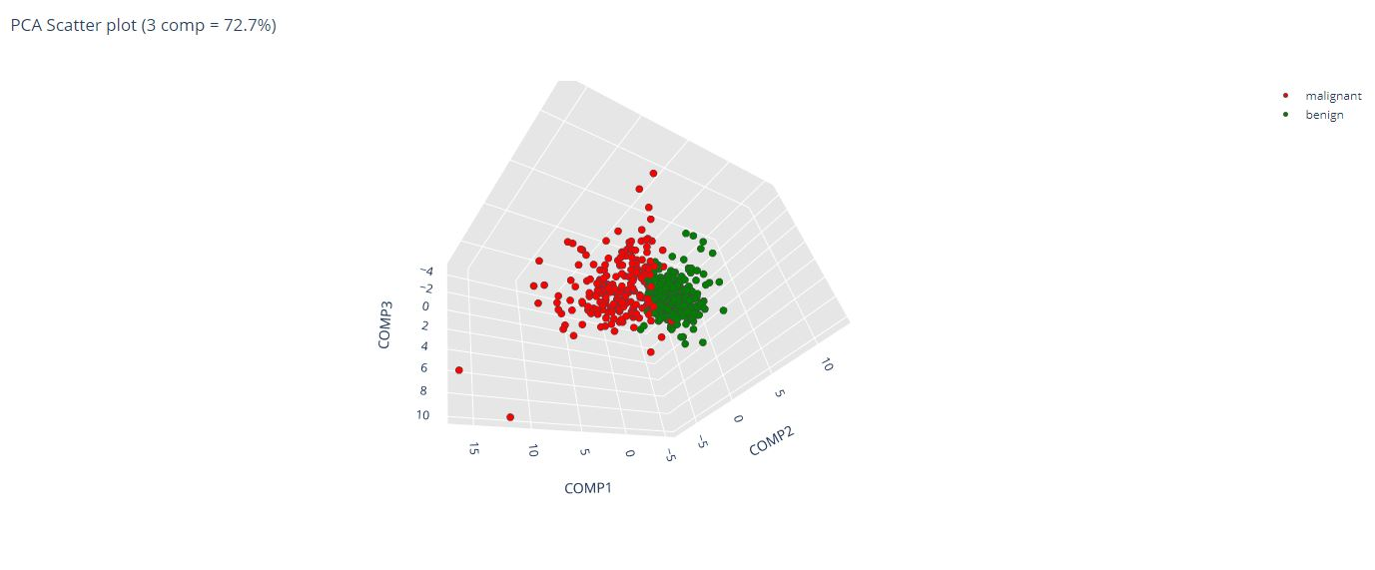
MODULE DESCRIPTION
2021- 22
BREAST CANCER DETECTION SYSTEM
Module 2:Principal Component Analysis:
In this module, we summarize information from large data tables to a smaller set.
PCA is very helpful when we are dealing with a lot of features as we are here in this project
Example from the project:
15

Slide 17
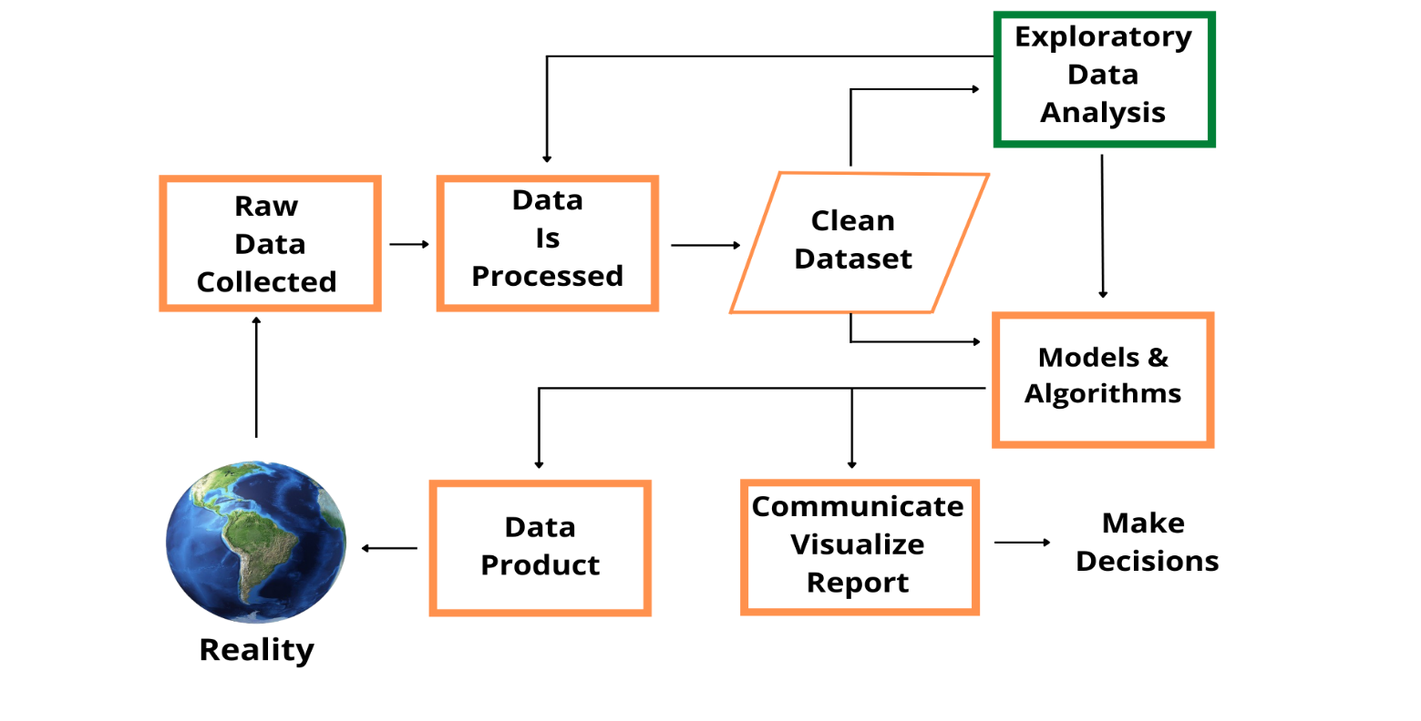
DATA FLOW DIAGRAM
2021- 22
BREAST CANCER DETECTION SYSTEM
Module 1:Exploratory Data analysis:
16

Slide 18
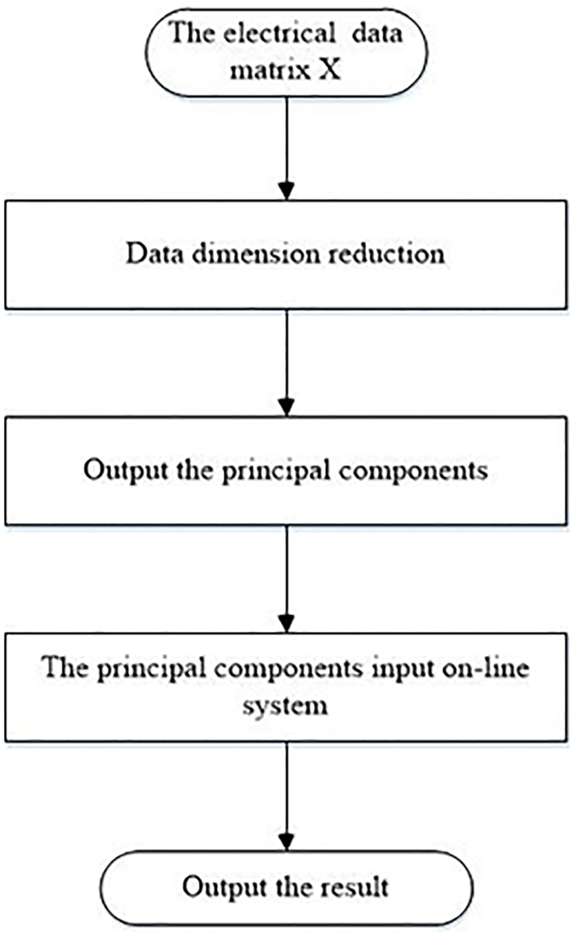
DATA FLOW DIAGRAM
2021- 22
BREAST CANCER DETECTION SYSTEM
Module 2:Principal Component Analysis:
17

Slide 19
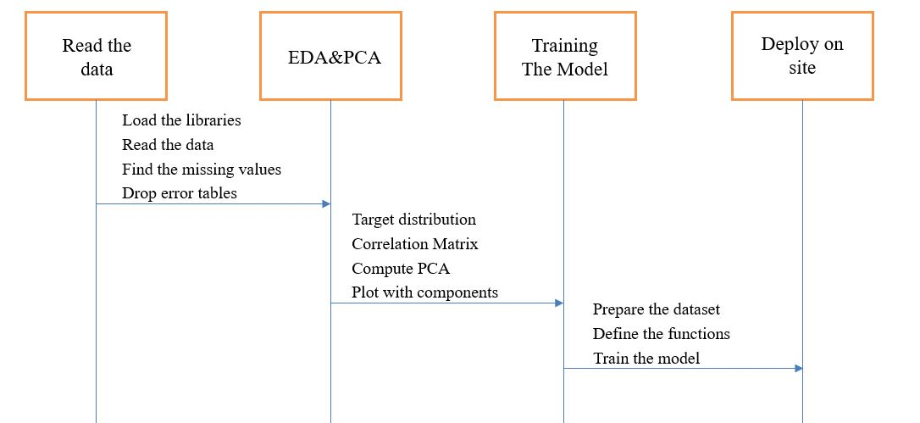
SEQUENCE DIAGRAM
2021- 22
BREAST CANCER DETECTION SYSTEM
18

Slide 20
CODE SNIPPETS
2021- 22
BREAST CANCER DETECTION SYSTEM
Module 1:Exploratory Data Analysis:
#We have two datasets one is Malignant and the other is benign
M = data[(data['diagnosis'] != 0)]
B = data[(data['diagnosis'] == 0)]
# count of the data avaialble
trace = go.Bar(x = (len(M), len(B)), y = ['malignant', 'benign'], orientation = 'h', opacity = 0.8, marker=dict(
color=[ 'red', 'green'],
line=dict(color='#000000',width=1.5)))
layout = dict(title = 'Count of diagnosis variable')
fig = dict(data = [trace], layout=layout)
py.iplot(fig)
19

Slide 21
CODE SNIPPETS
2021- 22
BREAST CANCER DETECTION SYSTEM
Module 1:Exploratory Data Analysis(Continued)
#Calculating the Percentage
trace = go.Pie(labels = ['benign','malignant'], values = data['diagnosis'].value_counts(),
textfont=dict(size=15), opacity = 0.8,
marker=dict(colors=[‘red', ‘green'],
line=dict(color='#000000', width=1.5)))
layout = dict(title = 'Distribution of diagnosis variable')
fig = dict(data = [trace], layout=layout)
py.iplot(fig)
20

Slide 22
CODE SNIPPETS
2021- 22
BREAST CANCER DETECTION SYSTEM
Module 1:Exploratory Data Analysis(Continued)
def plotDistribution(dataSelect, sizeBin) :
tmp1 = M[dataSelect]
tmp2 = B[dataSelect]
histData = [tmp1, tmp2]
group_labels = ['malignant', 'benign']
colors = ['red', 'green']
fig = ff.create_distplot(histData, group_labels, colors = colors, show_hist = True, bin_size = sizeBin, curve_type='kde')
fig['layout'].update(title = dataSelect)
py.iplot(fig, filename = 'Density plot')
21

Slide 23
CODE SNIPPETS
2021- 22
BREAST CANCER DETECTION SYSTEM
Module 1:Exploratory Data Analysis(Continued)
#Plotting
plot_distribution('radius_mean', .5)
plot_distribution('texture_mean', .5)
plot_distribution('perimeter_mean', 5)
plot_distribution('area_mean', 10)
plot_distribution('smoothness_mean', .5)
plot_distribution('compactness_mean', .5)
plot_distribution('concavity_mean', .5)
plot_distribution('concave points_mean', .5)
plot_distribution('symmetry_mean', .5)
plot_distribution('fractal_dimension_mean', .5)
22

Slide 24
CODE SNIPPETS
2021- 22
BREAST CANCER DETECTION SYSTEM
Module 2:Principal Component Analysis:
targetPCA = data['diagnosis']
dataPCA = data.drop('diagnosis', axis=1)
targetPCA = pd.DataFrame(targetPCA)
#To make a PCA, normalization of the data is essential
X_pca = dataPCA.values
X_std = StandardScaler().fit_transform(X_pca)
pca = PCA(svd_solver='full')
pca_std = pca.fit(X_std, targetPCA).transform(X_std)
pca_std = pd.DataFrame(pca_std)
pca_std = pca_std.merge(targetPCA, left_index = True, right_index = True, how = 'left')
pca_std['diagnosis'] = pca_std['diagnosis'].replace({1:'malignant',0:'benign'})
23

Slide 25
CODE SNIPPETS
2021- 22
BREAST CANCER DETECTION SYSTEM
Module 2:Principal Component Analysis(Continued)
labels = ['COMP1','COMP2','COMP3','COMP4','COMP5','COMP6', 'COMP7 - 30']
colors = ['#FBFF00', '#68FF00', '#C80000', '#054D0C', '#8A03B9', '#FE2E01', '#FFFFFF']
trace = go.Pie(labels = labels, values = var_pca[0].values, opacity = 0.8,
textfont=dict(size=15),
marker=dict(colors=colors,
line=dict(color='#9A9695', width=1.5)))
layout = dict(title = 'PCA : Components and explained variance (6 comp = 88.8%)')
fig = dict(data = [trace], layout=layout)
py.iplot(fig)
24

Slide 26
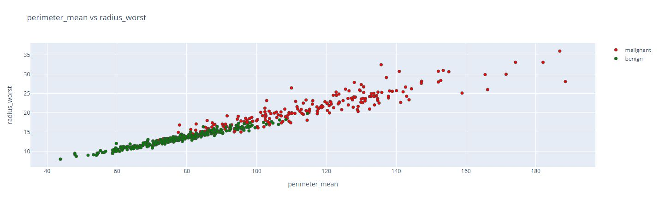
RESULTS
2021- 22
BREAST CANCER DETECTION SYSTEM
25

Slide 27
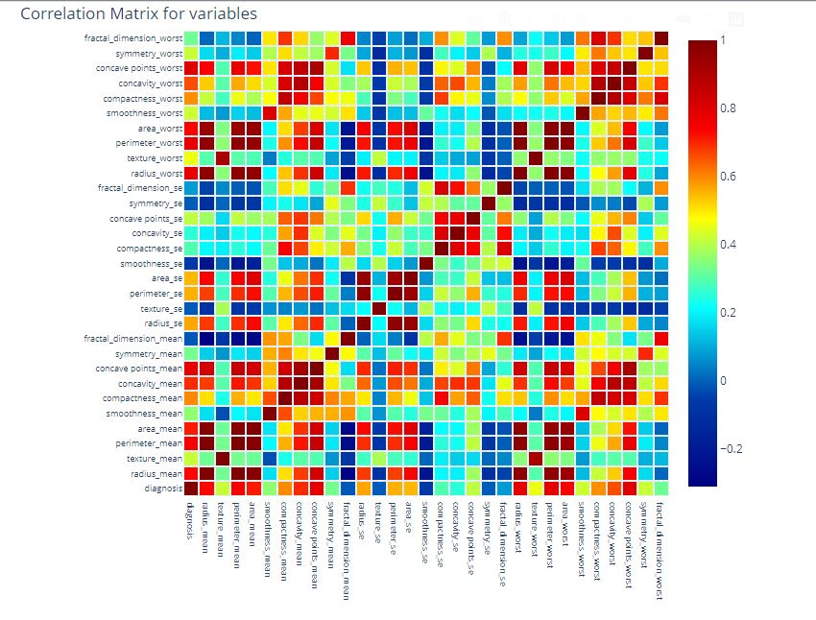
RESULTS
2021- 22
BREAST CANCER DETECTION SYSTEM
26

Slide 28
EXPECTED OUTCOME
2021- 22
BREAST CANCER DETECTION SYSTEM
Breast cancer rates in India have ever been increasing. There is very little knowledge about it among the rural population in particular ,and urban population seem to be ignorant of the idea.
We hope to deploy our project on a website to make the process easier and faster.
This can then be implemented in hospitals and clinics around us to combat the disease in early stages.
27

Slide 29
REFERENCES
2021- 22
BREAST CANCER DETECTION SYSTEM
Fatima, Noreen; Liu, Li; Sha, Hong; Ahmed, Haroon (2020). Prediction of Breast Cancer, Comparative Review of Machine Learning Techniques and their Analysis. IEEE Access, (), 1–1. doi:10.1109/ACCESS.2020.3016715
Gupta, Ankur; Kaushik, Dushyant; Garg, Muskan; Verma, Apurv (2020). [IEEE 2020 Fourth International Conference on I-SMAC (IoT in Social, Mobile, Analytics and Cloud) (I-SMAC) - Palladam, India (2020.10.7-2020.10.9)] 2020 Fourth International Conference on I-SMAC (IoT in Social, Mobile, Analytics and Cloud) (I-SMAC) - Machine Learning model for Breast Cancer Prediction. , (), 472–477. doi:10.1109/I-SMAC49090.2020.9243323
Vinayak A. Telsang;Kavyashree Hegde; (2020). Breast Cancer Prediction Analysis using Machine Learning Algorithms . 2020 International Conference on Communication, Computing and Industry 4.0 (C2I4), (), –. doi:10.1109/c2i451079.2020.9368911
Md.Razu Ahmed;Md. Asraf Ali;Joy Roy;Shakil Ahmed;N. Ahmed; (2020). Breast Cancer Risk Prediction based on Six Machine Learning Algorithms . 2020 IEEE Asia-Pacific Conference on Computer Science and Data Engineering (CSDE), (), –. doi:10.1109/csde50874.2020.9411572
28

Slide 30
THANK YOU
2021- 22
BREAST CANCER DETECTION SYSTEM
29

